Slide 1
Operating System Design
Chapter 12
Tanenbaum & Bos, Modern Operating Systems: 4th ed., Global Edition (c) 2015 Pearson Education Limited. All rights reserved.

Slide 2
Goals
Main goals of general purpose operating systems:
Define abstractions.
Provide primitive operations.
Ensure isolation.
Manage the hardware.
Tanenbaum & Bos, Modern Operating Systems: 4th ed., Global Edition (c) 2015 Pearson Education Limited. All rights reserved.

Slide 3
Interface Design
Guiding Principles
Simplicity
Completeness
Efficiency
Tanenbaum & Bos, Modern Operating Systems: 4th ed., Global Edition (c) 2015 Pearson Education Limited. All rights reserved.

Slide 4
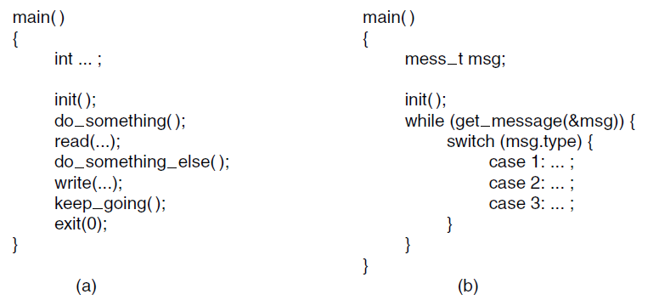
Execution Paradigms
Figure 12-1. (a) Algorithmic code. (b) Event-driven code.
Tanenbaum & Bos, Modern Operating Systems: 4th ed., Global Edition (c) 2015 Pearson Education Limited. All rights reserved.

Slide 5
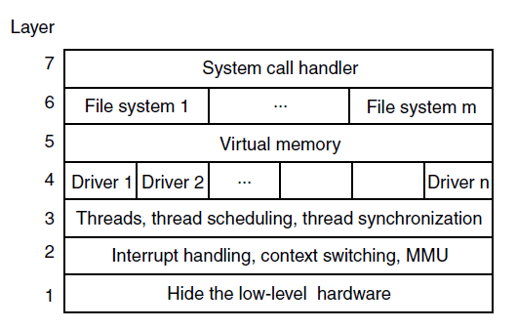
System Structure
Layered Systems
Figure 12-2. One possible design for a modern layered operating system.
Tanenbaum & Bos, Modern Operating Systems: 4th ed., Global Edition (c) 2015 Pearson Education Limited. All rights reserved.

Slide 6
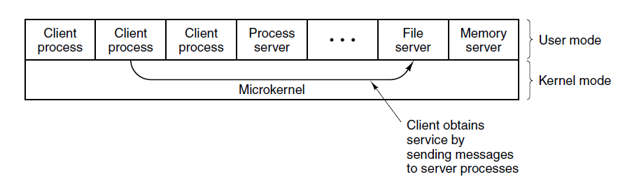
Microkernel-Based
Client-Server Systems
Figure 12-3. Client-server computing based on a microkernel.
Tanenbaum & Bos, Modern Operating Systems: 4th ed., Global Edition (c) 2015 Pearson Education Limited. All rights reserved.

Slide 7
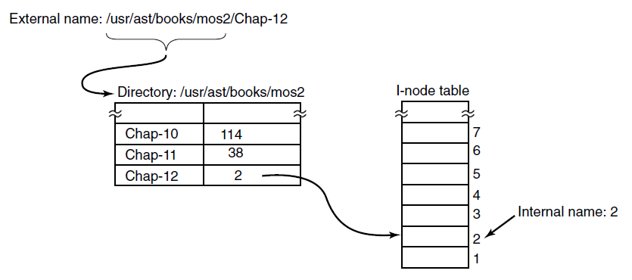
Naming
Figure 12-4. Directories are used to map external
names onto internal names.
Tanenbaum & Bos, Modern Operating Systems: 4th ed., Global Edition (c) 2015 Pearson Education Limited. All rights reserved.

Slide 8
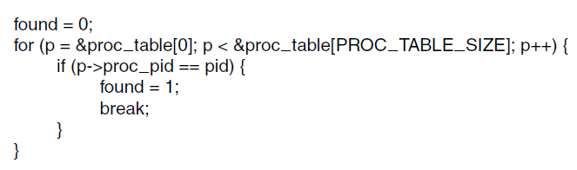
Static vs. Dynamic Structures
Figure 12-5. Code for searching the process
table for a given PID.
Tanenbaum & Bos, Modern Operating Systems: 4th ed., Global Edition (c) 2015 Pearson Education Limited. All rights reserved.

Slide 9
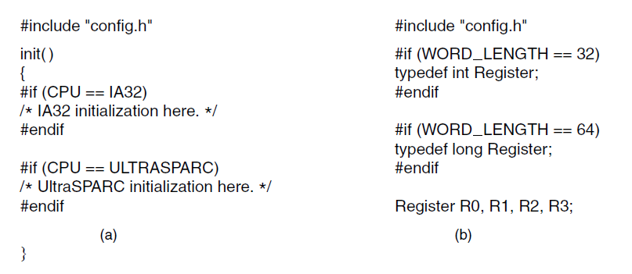
Hiding the Hardware
Figure 12-6. (a) CPU-dependent conditional compilation.
(b) Word-length-dependent conditional compilation.
Tanenbaum & Bos, Modern Operating Systems: 4th ed., Global Edition (c) 2015 Pearson Education Limited. All rights reserved.

Slide 10
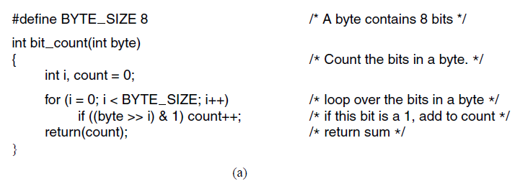
Space-Time Trade-offs (1)
Figure 12-7. (a) A procedure for counting bits in a byte.
Tanenbaum & Bos, Modern Operating Systems: 4th ed., Global Edition (c) 2015 Pearson Education Limited. All rights reserved.

Slide 11
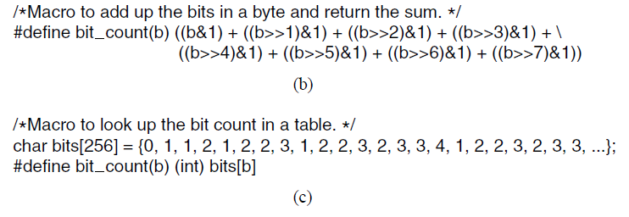
Space-Time Trade-offs (2)
Figure 12-7. (b) A macro to count the bits. (c) A macro that counts bits by table lookup.
Tanenbaum & Bos, Modern Operating Systems: 4th ed., Global Edition (c) 2015 Pearson Education Limited. All rights reserved.

Slide 12
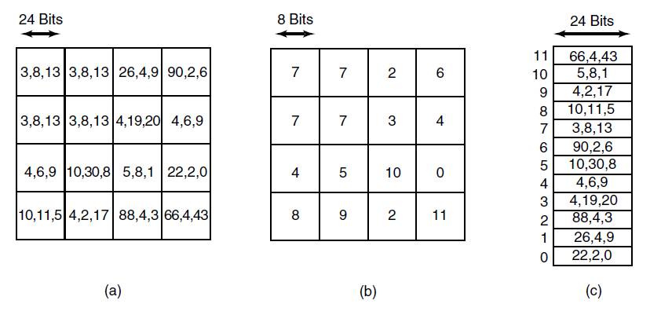
Space-Time Trade-offs (3)
Figure 12-8. (a) Part of an uncompressed image with 24 bits per pixel. (b) The same part compressed with GIF, with 8 bits per pixel. (c) The color palette.
Tanenbaum & Bos, Modern Operating Systems: 4th ed., Global Edition (c) 2015 Pearson Education Limited. All rights reserved.

Slide 13
Caching (1)
To look up /usr/ast/mbox requires the following disk accesses:
Read the i-node for the root directory (i-node 1).
Read the root directory (block 1).
Read the i-node for /usr (i-node 6).
Read the /usr directory (block 132).
Read the i-node for /usr/ast (i-node 26).
Read the /usr/ast directory (block 406).
Tanenbaum & Bos, Modern Operating Systems: 4th ed., Global Edition (c) 2015 Pearson Education Limited. All rights reserved.

Slide 14
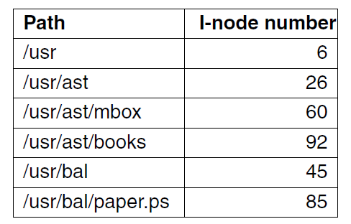
Caching (2)
Figure 12-9. Part of the i-node cache for Fig. 4-34.
Tanenbaum & Bos, Modern Operating Systems: 4th ed., Global Edition (c) 2015 Pearson Education Limited. All rights reserved.

Slide 15
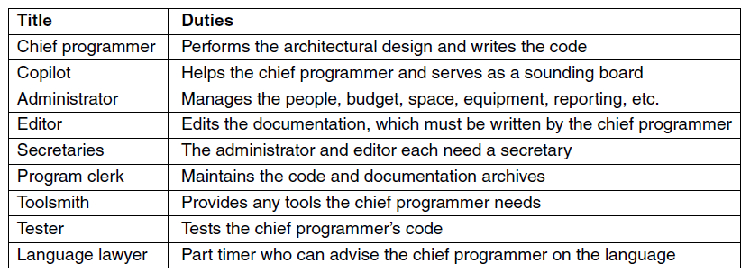
Project Management
Team Structure
Figure 12-10. Mills’ proposal for populating a
10-person chief programmer team.
Tanenbaum & Bos, Modern Operating Systems: 4th ed., Global Edition (c) 2015 Pearson Education Limited. All rights reserved.

Slide 16
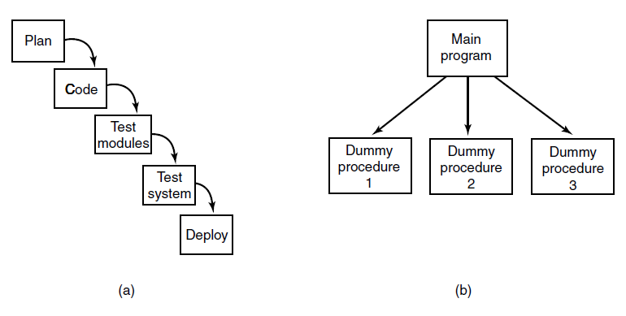
The Role of Experience
Figure 12-11. (a) Traditional software design progresses in stages. (b) Alternative design produces a working system (that does nothing) starting on day 1.
Tanenbaum & Bos, Modern Operating Systems: 4th ed., Global Edition (c) 2015 Pearson Education Limited. All rights reserved.

Slide 17
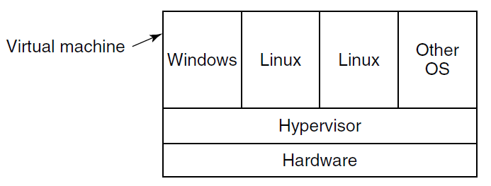
Trends In Operating System Design
Virtualization and the Cloud
Figure 12-12. A hypervisor running four virtual machines.
Tanenbaum & Bos, Modern Operating Systems: 4th ed., Global Edition (c) 2015 Pearson Education Limited. All rights reserved.

Slide 18
End
Chapter 12
Tanenbaum & Bos, Modern Operating Systems: 4th ed., Global Edition (c) 2015 Pearson Education Limited. All rights reserved.

